Slide 1

AWS Storage Services

Slide 2
Why Do We Need Different Storage Types?
Different Storage Needs
  Object storage for files, media, backups, and logs – S3 Bucket
  Block storage for operating systems and databases – Elastic Block Store
  File storage for shared files across multiple servers – Elastic File System
  Archive storage for rarely accessed long-term data – S3 Glacier

Slide 3
Amazon S3
What is Amazon S3?
  Amazon Simple Storage Service is an object storage service
  Stores data as objects inside buckets
  Suitable for documents, images, videos, backups, logs, and application files
  Fully managed by AWS
  Storage capacity scales automatically
S3 Buckets
  Logical containers for objects
  Bucket names are globally unique
  Each bucket is created in a specific AWS Region
  Bucket settings can control access, encryption, versioning, lifecycle, logging, and replication
S3 Objects
  Actual data stored in S3
  An object contains data, an object key, metadata, and optionally a version ID
  Objects can represent documents, media, backups, logs, and software packages
Object Keys and Prefixes
  S3 uses object keys rather than a traditional folder hierarchy
  Prefixes create a folder-like structure
  Example: company-data/logs/application.log

Slide 4
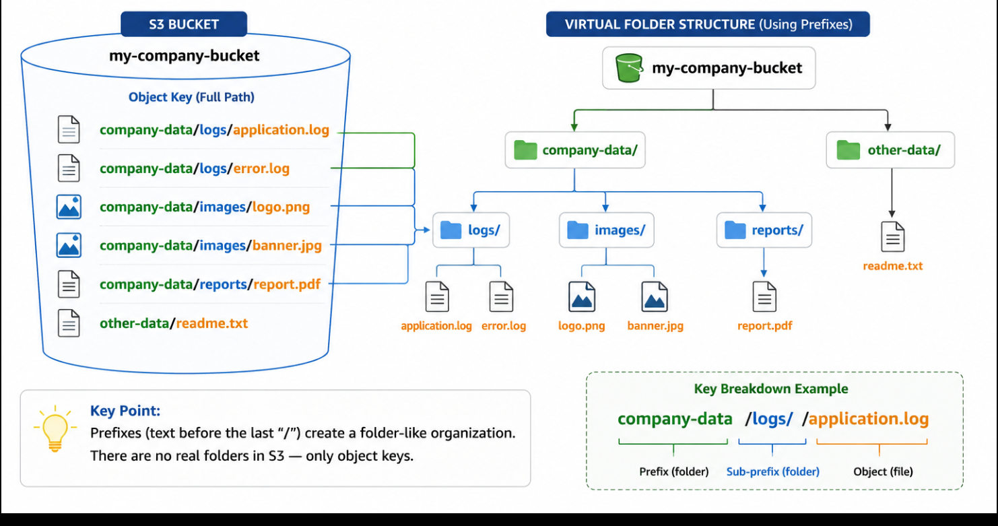

Slide 5
S3 Storage Classes
Available Classes
  S3 Standard — frequently accessed data
  S3 Standard-IA — infrequently accessed data
  S3 One Zone-IA — infrequently accessed, recreatable data
  S3 Intelligent-Tiering — automatic cost optimization based on access patterns
  S3 Glacier Instant Retrieval — archive with immediate access
  S3 Glacier Flexible Retrieval — archive with retrieval in minutes to hours
  S3 Glacier Deep Archive — very long-term archive
Choosing a Class
  Frequently accessed → S3 Standard
  Infrequently accessed → Standard-IA or One Zone-IA
  Unknown or changing access pattern → Intelligent-Tiering
  Archived but immediate access required → Glacier Instant Retrieval
  Long-term archive → Glacier Flexible Retrieval or Deep Archive

Slide 6
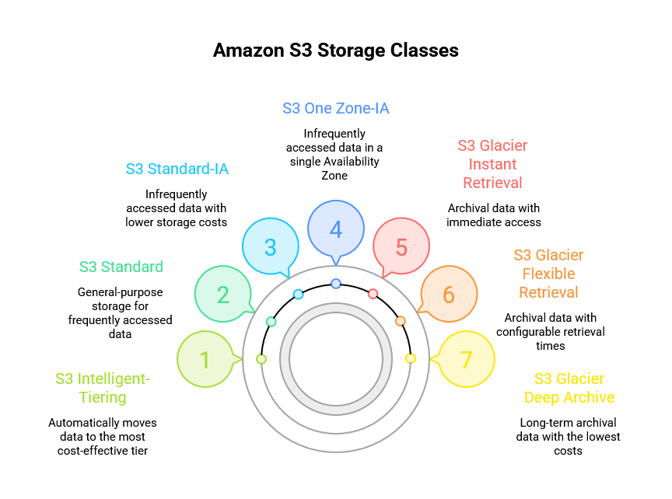

Slide 7
S3 Classes: Cost and Availability as Access Changes
Class | Best when access is | Cost effect | Availability effect
Standard | Frequent (new content) | Highest storage price; no retrieval fee | Multi-AZ; highest availability
Intelligent-Tiering | Unknown or changing | Small monitoring fee; automatic tiering; no retrieval fee | Multi-AZ
Standard-IA | Infrequent, needs fast access | Lower storage price; retrieval fee and minimum duration | Multi-AZ; slightly lower availability design
One Zone-IA | Infrequent, recreatable data | Cheapest infrequent-access option | Single AZ: data lost if that AZ fails; lower availability
Glacier classes | Archive, rarely read | Lowest storage price; retrieval fees and delays | Durable; access time depends on class
Analysis chain: new, hot data → Standard; unpredictable access → Intelligent-Tiering; older but still read → Standard-IA.
Saving vs risk: One Zone-IA lowers cost but keeps data in one AZ, so availability and AZ-failure protection fall.
Archive: move rarely used data to Glacier with lifecycle rules; accept retrieval fees and delay.
Notes:
Q17. Cost falls and retrieval effort rises from Standard to Glacier. One Zone-IA is the only IA class stored in a single AZ. Added standard AWS knowledge (fees, AZ placement); verify current pricing and availability figures in AWS docs.

Slide 8
S3 Lifecycle Management
Purpose
  Automates object transitions between storage classes
  Can automatically expire or delete objects
  Reduces administrative effort
  Optimizes storage costs
Example Lifecycle
  Day 0 → S3 Standard
  After 30 days → S3 Standard-IA
  After 6 months → Glacier Flexible Retrieval
  After retention period → Delete

Slide 9
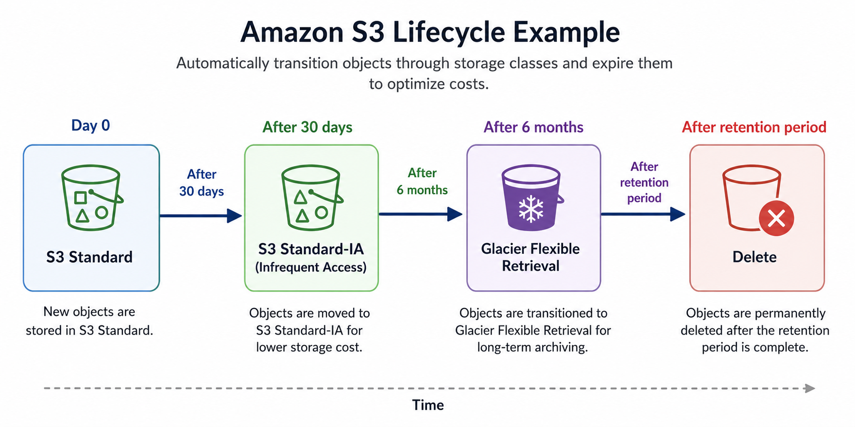

Slide 10
S3 Versioning
Purpose
  Maintains multiple versions of an object
  Protects against accidental deletion
  Protects against accidental overwriting
  Allows previous versions to be restored
Important Consideration
  Multiple versions consume additional storage
  Combine versioning with lifecycle rules to control costs

Slide 11
S3 Replication
Replication Types
  Same-Region Replication (SRR) — copies objects between buckets in the same Region
  Cross-Region Replication (CRR) — copies objects to another AWS Region
Use Cases
  Disaster recovery
  Compliance requirements
  Geographic distribution
  Improved availability and regional access

Slide 12
Versioning and Replication:
How they protect data together
  Versioning: a delete or overwrite keeps earlier versions (a delete marker hides the object)
  Replication (CRR): a second copy exists in another Region if the source Region fails
  Replication requires versioning to be enabled on both source and destination buckets
Cost implications
  Every stored version is billed, and replicated versions are stored again in the destination
  Replication adds request charges, plus inter-Region data transfer for CRR
  Control cost with lifecycle rules: expire noncurrent versions or move them to cheaper classes
Management implications
  Two buckets, a replication role and rules to maintain; monitor replication status and failures
  Decide how delete markers replicate; permanent deletes by version ID are not replicated by default
Notes:
Q18. Versioning handles accidental delete/overwrite in one bucket; replication handles Regional failure. Added standard AWS knowledge: replication needs versioning on both buckets; delete-marker behaviour; cost items. Verify current pricing and replication behaviour in AWS docs.

Slide 13
S3 Glacier
What is S3 Glacier?
  Low-cost archival storage within the Amazon S3 family
  Designed for rarely accessed data
  Optimized for long-term retention
  Retrieval generally takes longer than standard S3 storage
Why Glacier is Needed
  Organizations generate large amounts of historical data
  Archived data may rarely be accessed
  Keeping inactive data in premium storage increases cost
  Glacier provides economical long-term storage

Slide 14
Glacier Storage Classes
Glacier Classes
  Glacier Instant Retrieval — archive with immediate access
  Glacier Flexible Retrieval — retrieval in minutes to hours depending on option
  Glacier Deep Archive — lowest-cost option for very long-term retention
Typical Uses
  Medical and digital archives → Instant Retrieval
  Backups and disaster recovery → Flexible Retrieval
  Legal, regulatory, and historical archives → Deep Archive

Slide 15
Glacier Retrieval Options
Retrieval Options
Expedited — fastest retrieval for urgent needs
Standard — balanced retrieval speed and cost
Bulk — lowest retrieval cost for large amounts of data
Trade-Off
Faster retrieval generally costs more
Slower retrieval can reduce retrieval cost

Slide 16
Glacier Lifecycle Management
Automation
S3 Lifecycle rules can move older objects into Glacier storage classes
Reduces manual archive management
Useful for large numbers of objects
Example
Active data → S3 Standard
Older data → S3 Standard-IA
Archive data → Glacier Flexible Retrieval
Very old data → Glacier Deep Archive

Slide 17
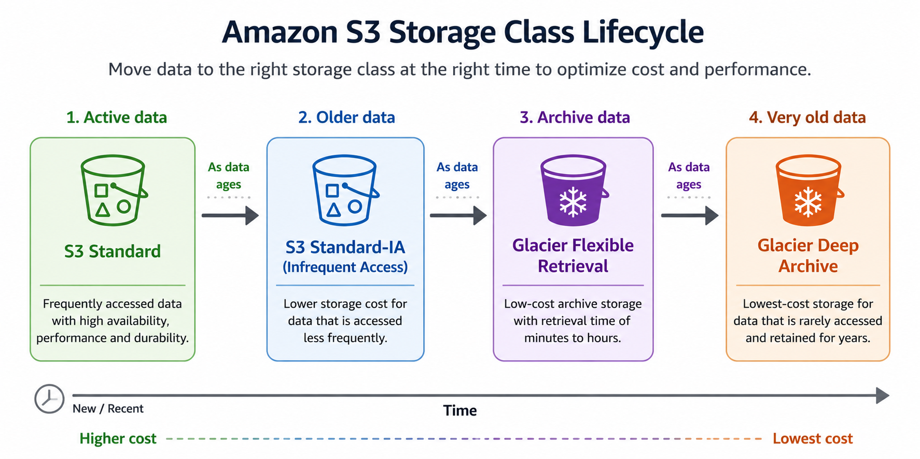

Slide 18
Glacier Security and Disaster Recovery
Security
Encryption at rest
Encryption in transit where applicable
AWS KMS integration
IAM and bucket policies
AWS CloudTrail for auditing
Disaster Recovery
Store database backups and application backups
Maintain long-term recovery copies economically
Restore archived data when production systems fail

Slide 19
Amazon EBS
What is Amazon EBS?
Amazon Elastic Block Store provides block-level storage
Primarily used with Amazon EC2
Appears to the operating system as a disk
Suitable for operating systems, databases, applications, and business data
Key Characteristic
EBS is persistent storage
Data remains available when an EC2 instance is stopped
Volumes can be attached and detached as required

Slide 20
How Amazon EBS Works
EBS Architecture
EC2 instance → EBS volume
Root volume stores the operating system
Additional volumes can store application and database data
EBS volume is independent of the EC2 instance lifecycle
Management
Create volumes as required
Attach or detach volumes
Increase capacity when needed
Manage using AWS Console, CLI, or Infrastructure as Code

Slide 21

EBS Volume Types
SSD Types
gp3 — general-purpose SSD and recommended for most workloads
gp2 — previous-generation general-purpose SSD
io2 and io1 — Provisioned IOPS SSD for demanding workloads
HDD Types
st1 — Throughput Optimized HDD for sequential workloads
sc1 — Cold HDD for low-cost, infrequently accessed block storage

Slide 22
Choosing an EBS Volume Type
Workload Selection
  General applications → gp3
  Operating system disk → gp3
  High-performance transactional database → io2
  Large sequential data processing → st1
  Low-performance persistent data → sc1

Slide 23

Amazon EBS Snapshots
What is a Snapshot?
Point-in-time backup of an EBS volume
Used for backup, recovery, migration, and disaster recovery
Subsequent snapshots are incremental
Snapshot Process
EBS volume → Create snapshot → Snapshot storage → Restore snapshot → New EBS volume

Slide 24

EBS Snapshot Recovery
Restore Process
Create or select a snapshot
Create a new EBS volume from the snapshot
Attach the restored volume to an EC2 instance
Recover application or user data
Disaster Recovery
Snapshots can be copied to another AWS Region
Cross-Region copies support disaster recovery strategies
Snapshots remain independent of the original volume

Slide 25
EBS Encryption and Security
Encryption
EBS supports encryption
Protects stored volume data
Snapshots can also be encrypted
AWS KMS manages encryption keys
Access Control
IAM controls permissions for EBS resources
Administrators can control who can create, attach, modify, and delete volumes and snapshots

Slide 26
Amazon EFS
What is Amazon EFS?
Amazon Elastic File System is a managed file storage service
Primarily designed for Linux workloads
Uses the Network File System (NFS) protocol
Multiple EC2 instances can access the same file system
Automatically scales as data changes
Key Idea
EFS provides shared file storage
Multiple servers can read and write common files

Slide 27

How Amazon EFS Works
Architecture
AWS Region → EFS file system
EC2 instances → NFS connections → EFS
Multiple instances access the same files
Benefits
No need to manage file servers
No need to pre-provision storage capacity
Shared access across application servers

Slide 28
EFS Key Features
Features
  Fully managed file storage
  Automatic scalability
  Shared file access
  High availability across multiple Availability Zones
  Encryption support
  Lifecycle management

Slide 29
EFS Performance Modes
General Purpose
  Default choice for most workloads
  Low latency
  Suitable for web applications, content management systems, and business applications
Max I/O
  Designed for high levels of concurrent access
  Suitable for large distributed workloads
  Can have higher latency than General Purpose

Slide 30
EFS Throughput Modes
Elastic Throughput
Automatically adjusts throughput according to workload demand
Suitable for unpredictable or changing workloads
Provisioned Throughput
Administrator specifies a throughput level
Suitable when a consistent throughput requirement is known

Slide 31
EFS Storage Classes and Lifecycle
Storage Classes
EFS Standard — frequently accessed files
EFS Infrequent Access — less frequently accessed files at lower storage cost
Lifecycle Management
Automatically moves inactive files to lower-cost storage
Reduces manual storage management
Helps optimize EFS costs

Slide 32

EFS Security
Access Control
IAM controls AWS-level permissions
Security Groups control network access
NFS permissions control file access
Encryption
Encryption at rest using AWS KMS
TLS can protect data in transit

Slide 33
S3 vs Glacier vs EBS vs EFS
Storage Comparison
S3 → Object storage
Glacier → Archival object storage
EBS → Block storage
EFS → Shared file storage
Best Use
S3 → Files, media, logs, backups, application objects
Glacier → Long-term archival data
EBS → EC2 operating systems, databases, applications
EFS → Shared files across multiple EC2 instances

Slide 34
Real-World AWS Storage Architecture
Web Application
Users → Load Balancer → Multiple EC2 instances
EBS provides instance disk storage
EFS provides shared application files
S3 stores images, videos, and static objects
EBS snapshots provide backup and recovery
Backup Strategy
Active application data → EBS ( That can be Snapshot)
Backup objects → S3 Bucket
Older backups → Glacier
Long-term archives → Glacier Deep Archive

Slide 35
Key Takeaways
Remember
  S3 stores objects inside buckets
  S3 Lifecycle automates storage transitions and deletion
  S3 Versioning protects against accidental changes and deletion
  S3 Replication supports disaster recovery and geographic distribution
  Glacier provides low-cost long-term archival
  EBS provides persistent block storage for EC2
  EBS Snapshots provide point-in-time backups
  EFS provides shared file storage for multiple EC2 instances

Slide 36
Quick Student Check
Questions
  Which service should you use for storing images and videos?
  Which service behaves like a virtual hard disk?
  Which service allows multiple EC2 instances to access the same file system?
  Which storage is suitable for data retained for many years but rarely accessed?
  What is the difference between an EBS volume and an EBS snapshot?
  What does an S3 Lifecycle policy do?
  What is the difference between S3, EBS, and EFS?

